Slide 1

A look into nationwide mortality rates and the possible effect on healthcare costs

Slide 2

AGENDA
Aim of the Project
Foundational Questions
Healthcare Costs by Region
Mortality Rates Across the United States
Chronic Disease Mortality Rates Across the United States
Findings
Ethical Considerations

Slide 3

The aim of our project is to identify trends in healthcare outcomes. This project will look at the relationship between healthcare costs and death rates across the United States to find any correlation apparent that could show the following:

Slide 4

- Do higher mortality rates due to higher chronic illness lead to an increase in healthcare costs by region? - Do higher healthcare costs create a higher mortality rate due to inability to obtain proper healthcare? - What are the most cost friendly states to live in when it comes to healthcare?

Slide 5
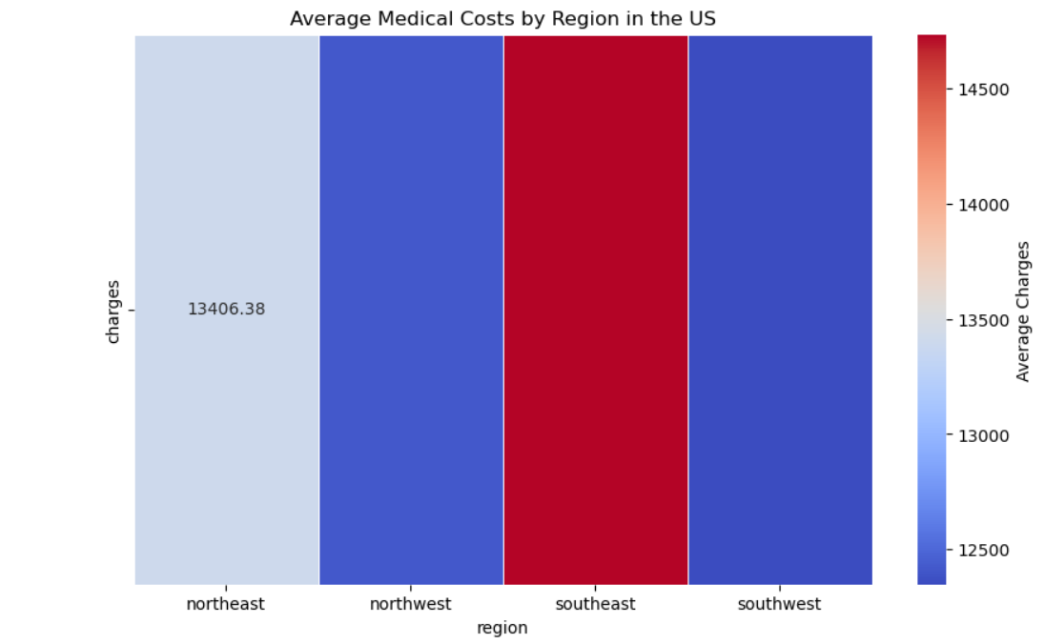

Slide 6
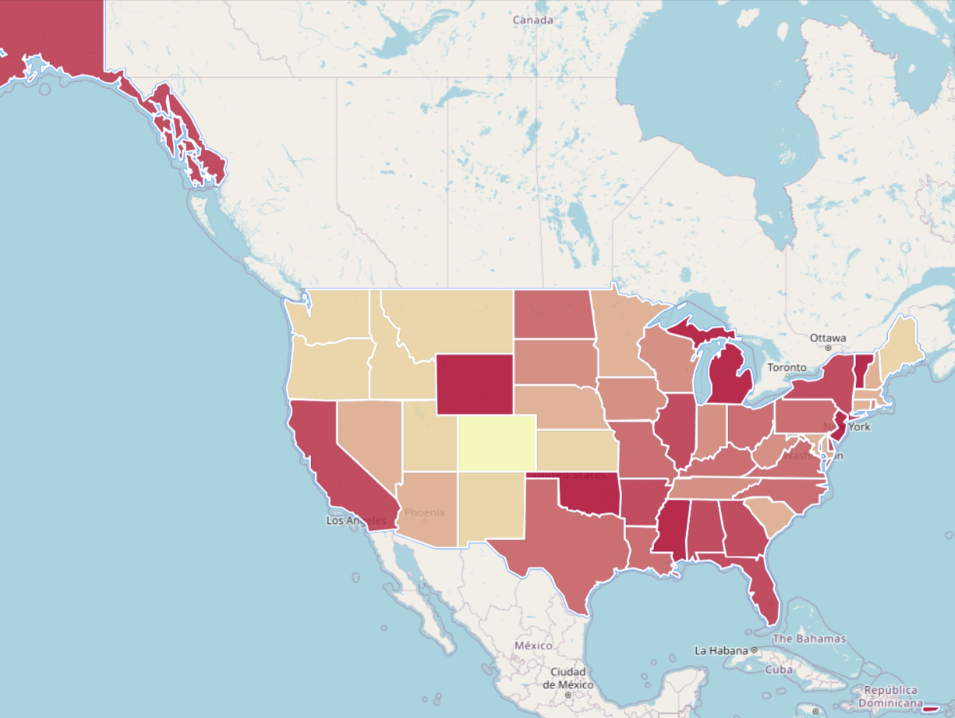
Mortality rates across the united states Heat Map of Deaths in USA (dference.github.io)

Slide 7
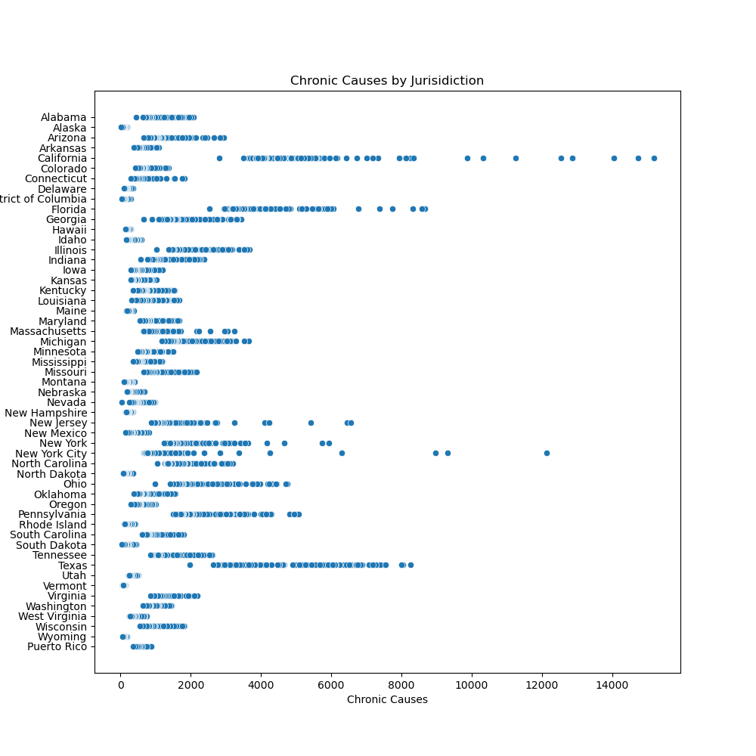
Chronic Disease Mortality Rates Across the United States

Slide 8
Findings
After reviewing the data in this project, we have come to the following conclusions:
The top 3 states in terms of healthcare costs are:
- Colorado
- Oregon
- Maine
States that have a higher trend of chronic caused deaths tend to have higher healthcare costs, although a look at overall cost of living in said states may show an increase in overall costs which affects healthcare coverage as well, and the per capita results will always show higher numbers in more populated states.
Looking at higher medical costs alone may not directly cause higher mortality, they do correlate with more broad health system performance, access to care, and overall quality of life. The highest shown region when it comes to cost DOES have high mortality rates, so it is not a given that they do not go hand in hand, but without other factors present you cannot fully endorse a statement saying high cost is the cause of high mortality rates.

Slide 9

Ethical Considerations
For this project, all data used was done so in compliance with HIPAA regulations, with data used following policies from the Department of Health and Human Services (HHS) protecting information from unwarranted disclosure.

Slide 10

Thank you

